Slide 1
DYNAMIC PROGRAMMING
ALGORITHM ANALYSIS
<<>>
Computer Science Department

Slide 2
DYNAMIC PROGRAMMING
Dynamic Programming is a general algorithm design technique for solving problems defined by or formulated as recurrences with overlapping sub-instances.
Invented by American mathematician Richard Bellman in the 1950s to solve optimization problems and later assimilated by CS
“Programming” here means “planning”
Main idea:
    set up a recurrence relating a solution to a larger instance to solutions of some smaller instances
    - solve smaller instances once
    record solutions in a table
    extract solution to the initial instance from that table
Computer Science Department

Slide 3
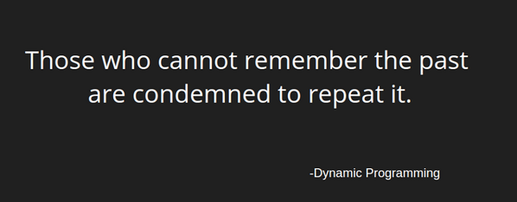
DYNAMIC PROGRAMMING
Is repeating the things for which you already have the answer, a good thing ?
Computer Science Department

Slide 4
DYNAMIC PROGRAMMING
*writes down "1+1+1+1+1+1+1+1 =" on a sheet of paper*
"What's that equal to?"
*counting* "Eight!"
*writes down another "1+" on the left*
"What about that?"
*quickly* "Nine!"
"How'd you know it was nine so fast?"
"You just added one more"
"So you didn't need to recount because you remembered there were eight! Dynamic Programming is just a fancy way to say 'remembering stuff to save time later'"
Computer Science Department

Slide 5
DYNAMIC PROGRAMMING
Method for solving complex problems by breaking them down into simpler subproblems
Dynamic programming is basically, recursion plus common sense.
The intuition behind dynamic programming is that we trade space for time, i.e. to say that instead of calculating all the states taking a lot of time but no space, we take up space to store the results of all the sub-problems to save time later.
Computer Science Department

Slide 6
DYNAMIC PROGRAMMING
Steps
Define subproblems
Write down the recurrence that relates subproblems
Recognize and solve the base cases
Computer Science Department

Slide 7
FIBONACCI NUMBERS
Recall definition of Fibonacci numbers:
  fib (n) = 1; if n = 0
  fib(n) = 1; if n = 1
  fib(n) = fib(n-1) + fib(n-2)
  So, the first few numbers in this series will be: 1, 1, 2, 3, 5, 8, 13, 21... and so on!
Computer Science Department

Slide 8
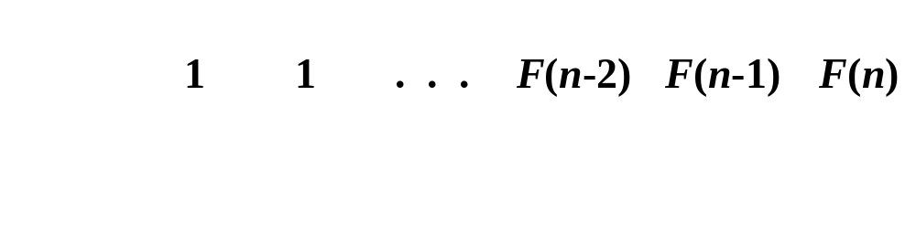
FIBONACCI NUMBERS
  Computing the n^{th} Fibonacci number using bottom-up iteration and recording results:
F(0) = 0
F(1) = 1
F(2) = 1+0 = 1
…
F(n-2) =
F(n-1) =
F(n) = F(n-1) + F(n-2)
Efficiency:
- time
- space
What if we solve it recursively?
n
n
Computer Science Department

Slide 9
FIBONACCI NUMBERS
Computing the n^{th} Fibonacci number recursively (top-down):
F(n)
F(n-1) + F(n-2)
F(n-2) + F(n-3) F(n-3) + F(n-4)
...
Computer Science Department

Slide 10
FIBONACCI NUMBERS
Code
int fib (int n) {
if (n < 2)
return 1;
return fib(n-1) + fib(n-2);
}
Computer Science Department

Slide 11

Computer Science Department

